Slide 1

TKR COLLEGE OF ENGINEERING & TECHNOLOGY
Autonomous
DEPARTMENT OF CSE
LOAN APPROVAL PREDICTIONS USING MACHINE LEARNING MODELS
BATCH NO : C3
20K91A05F2- R.GAYATHRI
20K91A05C6- NEHA
20K91A05B2 – MD.ABDUL GAFOOR
20K91A05B7 - M.AJAY KUMAR
GUIDE : Mrs. Y.LATHA

Slide 2
CONTENTS:
INTRODUCTION
ABSTRACTION
EXISTING SYSTEM
PROPOSED SYSTEM
LITERATURE SURVEY
FUNCTIONAL REQUIREMENTS
NON FUNCTIONAL REQUIREMENTS
ARCHITECTURE DIAGRAM

Slide 3
DATA FLOW DIAGRAM
UML DIAGRAMS
PSEUDO CODE
ALGORITHMS
MODULES DESCRIPTION
TESTING
OUTPUT SCREEN
CONCLUSION
FUTURE WORK

Slide 4
TITLE : LOAN APPROVAL PREDICTIONS USING MACHINE LEARNING MODELS
INTRODUCTION:
In recent years, the integration of machine learning algorithms into various domains has revolutionized decision-making processes and improved the efficiency of complex tasks. One such application is the prediction of loan approval using machine learning techniques. Traditional loan approval processes often involve a time-consuming and manual evaluation of numerous factors, leading to delays and sometimes inconsistent decisions. With the advent of machine learning, financial institutions can leverage advanced algorithms to automate and enhance the loan approval process. Machine learning models, such as classifiers, can be trained on historical data to analyze patterns and make predictions about the likelihood of loan approval based on various features. These features may include the applicant’s financial history, income, credit score, employment status, and other relevant factors. By incorporating machine learning, financial institutions can achieve faster, more accurate, and unbiased loan approval decisions.

Slide 5
ABSTRACT :
A bank’s profit or loss depends to a large extent on loans i.e. Whether the customers are paying back the loan or defaulting. By predicting the loan defaulters, the bank can reduce its Non – Performing Assets. Here we provided a brief contrast between the existing system and our proposed model to highlight the improvements. The system architecture and requirements are presented in the subsequent slides. The data is collected from the Kaggle for studying and prediction. Logistic Regression, SVM, Random Forest, XGBoost, AdaBoost models are included in the base stack for the stacking algorithm in Ensemble Learning. XGBoost model is taken as a meta model for prediction. The main objective of this project is to predict whether assigning the loan to a particular person will be safe or not. This project is divided into four sections
(i) Loading, Pre-processing data and EDA (ii) Model fitting and training (iii) Prediction and Performance tuning (iv) Output.

Slide 6
EXISTING SYSTEMS:
Logistic regression, SVM, Decision tree etc are all famous classification machine learning models which have been used in the prediction of Loan approval use case in Banking. The accuracy of popular classifiers for a generic dataset for loan approval is
Logistic Regression: 80% AdaBoost : 78% XGBoost: 79% Random tree forest : 81% Support Vector Machine : 69%

Slide 7
PROPOSED SYSTEMS:
The proposed model of the system is the Ensemble Learning model which combines individual models together to improve the stability and predictive power of the model. This learning model helps us to use the best qualities of each classifier included which works best for different aspects of the dataset. This augments the precision of the model. Our ensemble model is divided into two:
1) Base-model stack consisting of Random Forest, SVM, Linear Regression, 2) Meta-model : Gaussian NB

Slide 8
LITERATURE SURVEY :
S. No | ARTICLE | AUTHOR | YEAR OF PUBLICATION | METHODLOGY | PUBLISHER
01 | ML Based Loan Approval Prediction System – A Novel Approach | MKJ Khannan and AR Nithej | 2023 | Model training using pertinent datasets , pre-processing, algorithms like SVM, Logistic Regression for prediction | ijircce.com
02 | Customer Loan eligibility prediction using ML | A Shaik, KS Asritha, N Lahre | 2022 | User registration, data collection, analysis,preprocess, splitting, training, testing prediction using Random factor | Publishoa.com

Slide 9
S.No | ARTICLE | AUTHOR | YEAR OF PUBLICATION | METHODOLOGY | PUBLISHER
03 | Analysis of Loan Availability Using ML Techniques | Sharayu Dosalwar, Ketti Kinkar, Rahul Sannat | 2021 | Data Collection, data cleaning processing, model testing Prediction using Logistic Regression | IJARSCT
04 | ML techniques for Recognising the Loan Eligibility | Mr. AbhiRoop Sarkar | 2021 | Data collection processing, training, testing, Evaluation using Logistic Regression | IRJMETS

Slide 10
S.No | ARTICLE | AUTHOR | YEAR OF PUBLICATION | METHODOLOGY | PUBLISHER
05 | ML Algorithms to predict Fraudulent Loan Requests | Nazmul Hasan, Tanvir Anzam, Tareq Hasan, Nusrat Jahan | 2021 | Visualization pre-processing, Model implementation using KNN algorithm | IEEE
06 | Loan Default Identification and it’s Effect | Gopal Choudhary, Yash Gaurd, Akshil Shetty, Rumit Kadakia, Sonali Borase | 2019 | Loading previous datasets,training model, data analysis,cleaning,feature selection,outlier treatment using Random Forest | INSRCSEIT

Slide 11
FUNCTIONAL REQUIREMENTS:
HARDWARE: OS – Windows 7,8 or 10 (32 or 64 bit) RAM – 4GB
SOFTWARE:
Python
Anaconda Navigator Python built-in modules Numpy Pandas Matplotlib Sklearn Seaborn

Slide 12
NON FUNCTIONAL REQUIREMENTS:
Performance: How fast the system can process loan applications and make predictions accurately. Scalability: The ability to handle increasing amounts of data and users without sacrificing performance. Reliability: Ensuring the system is dependable and operates consistently under different conditions. Security: Safeguarding sensitive data, such as personal and financial information, from unauthorized access or breaches. Usability: Making the system easy to understand and interact with for users, such as loan officers or applicants.
Maintainability: How easily the system can be updated, fixed, or enhanced over time without disrupting its operations.

Slide 13
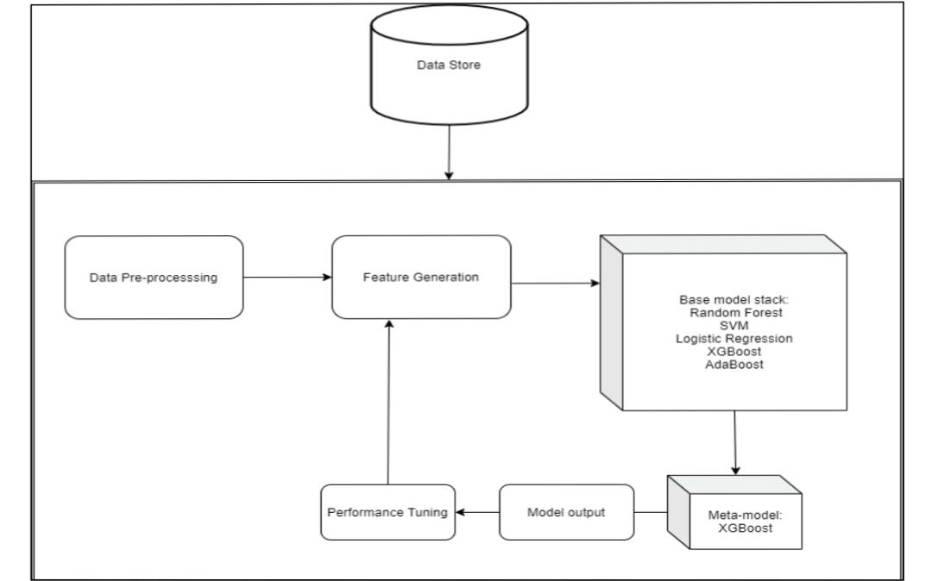
ARCHITECTURE DIAGRAM:

Slide 14
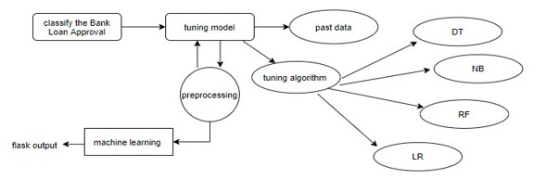
DATA FLOW DIAGRAM:

Slide 15
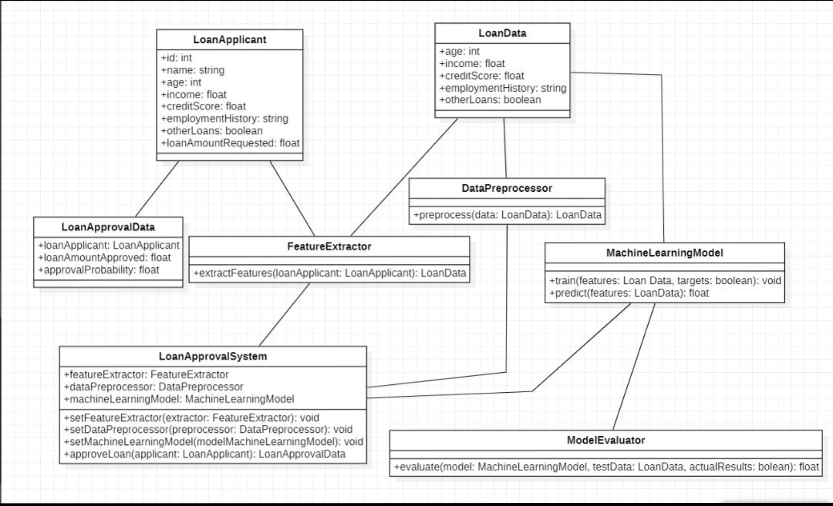
UML DIAGRAMS : 1. CLASS DIAGRAM :

Slide 16
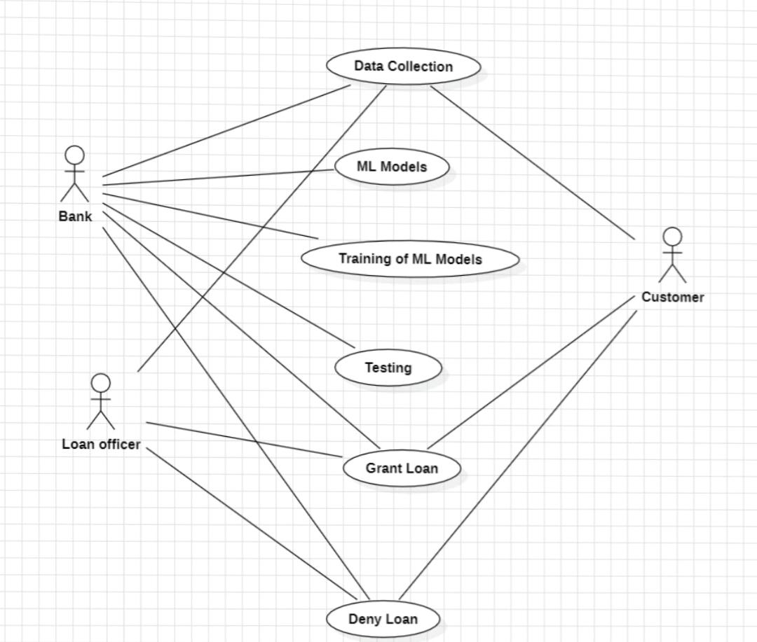
2. USECASE DIAGRAM:

Slide 17
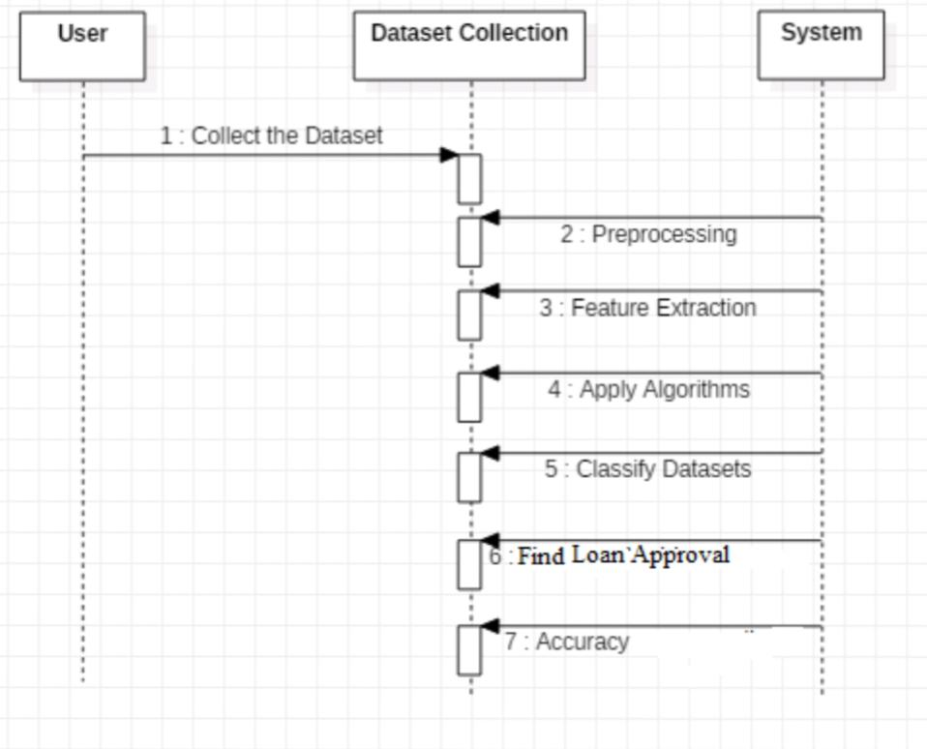
3. SEQUENCE DIAGRAM :

Slide 18
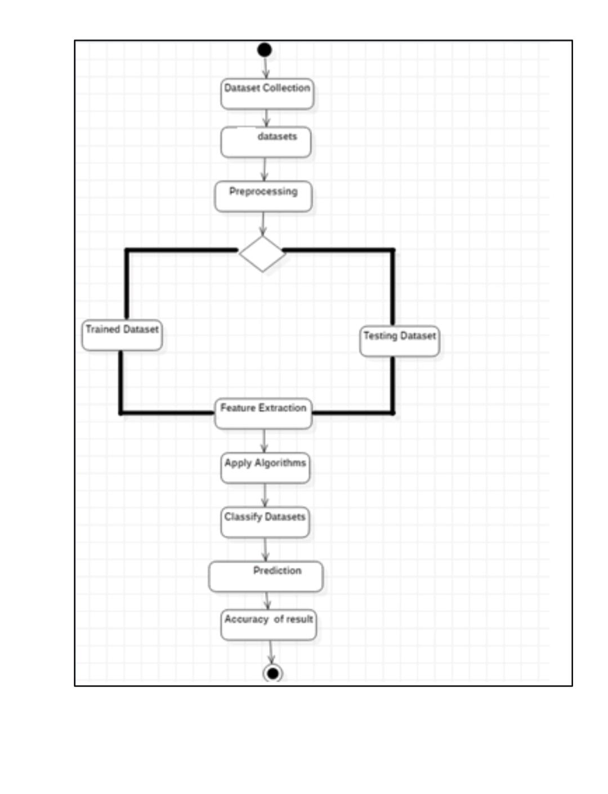
4. ACTIVITY DIAGRAM :

Slide 19
PSEUDO CODE:
# Step 1: Import necessary libraries import pandas as pd import numpy as np from sklearn.model_selection import train_test_split from sklearn.preprocessing import StandardScaler from sklearn.linear_model import LogisticRegression from sklearn.metrics import accuracy_score, classification_report # Step 2: Load the loan dataset loan_data = pd.read_csv(‘loan_dataset.csv’)

Slide 20
# Step 3: Pre-process the data # Handle missing values loan_data.fillna(0, inplace=True) # Filling missing values with 0 for simplicity # Encode categorical variables (if any) loan_data = pd.get_dummies(loan_data) # Normalize or scale numerical features Scaler = StandardScaler() loan_data[[‘income’, ‘loan_amount’, ‘credit_score’]] = scaler.fit_transform(loan_data[[‘income’, ‘loan_amount’, ‘credit_score’]]) # Step 4: Split the dataset into training and testing sets X = loan_data.drop(‘approval_status’, axis=1) y = loan_data[‘approval_status’] X_train, X_test, y_train, y_test = train_test_split(X, y, test_size=0.2, random_state=42)

Slide 21
# Step 5: Choose a machine learning algorithm for classification model = LogisticRegression() # Step 6: Train the classification model model.fit(X_train, y_train) # Step 7: Evaluate the model y_pred = model.predict(X_test) accuracy = accuracy_score(y_test, y_pred) print(“Accuracy:”, accuracy) print(“Classification Report:”) print(classification_report(y_test, y_pred)) # Step 8: Optionally, fine-tune hyper parameters # (not implemented in this example, but you can use techniques like grid search or random search)

Slide 22
ALGORITHMS:
Decision Tree Algorithm
Logistic Regression
Gaussian Naive Bayes

Slide 23
1.Decision Trees :
Decision trees are the building blocks of a random forest algorithm. A decision tree is a decision support technique that forms a tree-like structure. An overview of decision trees will help us understand how random forest algorithms work. A decision tree consists of three components: decision nodes, leaf nodes, and a root node. A decision tree algorithm divides a training dataset into branches, which further segregate into other branches. This sequence continues until a leaf node is attained. The leaf node cannot be segregated further. The nodes in the decision tree represent attributes that are used for predicting the outcome. Decision nodes provide a link to the leaves. The following diagram shows the three types of nodes in a decision tree.

Slide 24
The information theory can provide more information on how decision trees work. Entropy and information gain are the building blocks of decision trees. An overview of these fundamental concepts will improve our understanding of how decision trees are built. Entropy is a metric for calculating uncertainty. Information gain is a measure of how uncertainty in the target variable is reduced, given a set of independent variables. The information gain concept involves using independent variables (features) to gain information about a target variable (class). The entropy of the target variable (Y) and the conditional entropy of Y (given X) are used to estimate the information gain. In this case, the conditional entropy is subtracted from the entropy of Y. Information gain is used in the training of decision trees. It helps in reducing uncertainty in these trees. A high information gain means that a high degree of uncertainty (information entropy) has been removed. Entropy and information gain are important in splitting branches, which is an important activity in the construction of decision trees.

Slide 25
2.Logistic Regression:
Logistic Regression was used in the biological sciences in early twentieth century. It was then used in many social science applications. Logistic Regression is used when the dependent variable(target) is categorical For example,
-- To predict whether an email is spam (1) or (0) --Whether the tumour is malignant (1) or not (0)

Slide 26
3. Gaussian Naive Bayes Algorithm:
Gaussian Naive Bayes is a probabilistic classification algorithm based on Bayes’ theorem, assuming that features are independent and follow a Gaussian (normal) distribution. It is particularly well-suited for classification tasks where the features are continuous and can be modeled using a normal distribution.
Advantages:
Simple and Fast
Good for high dimensional data
Stable Performance
Handles Missing Data
Low Training time
Effective in text classification

Slide 27
MODULES:
1.DATA COLLECTION
2.DATA PRE-PROCESSING
3.FEATURE EXTRATION
4.EVALUATION MODEL

Slide 28
1.DATA COLLECTION :
Data used in this paper is a set of dataset.
This step is concerned with selecting the subset of all available data that you will be working with.
ML problems start with data preferably, lots of data for which you
already know the target answer.
Data for which you already know the target answer is called labelled data.

Slide 29
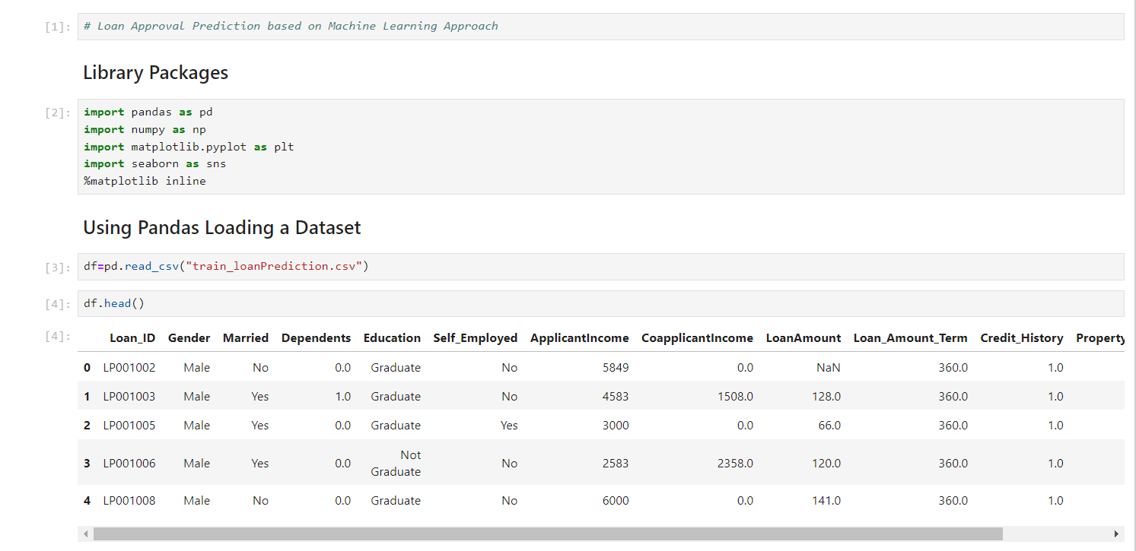

Slide 30
2. DATA PRE-PROCESSING :
Formatting:
The data you have selected may not be in a format that is suitable for you to work with. The data may be in a relational database and you would like it in a flat file, or the data may be in a proprietary file format and you would like it in a relational database or a text file
Cleaning:
Cleaning data is the removal or fixing of missing data.
There may be data instances that are incomplete and do not carry th data you believe you need to address the problem. These instances may need to be removed.
Sampling:
There may be far more selected data available than you need to work
with. More data can result in much longer running times for algorithms and larger computational and memory requirements. You can take a
smaller representative sample of the selected data that may be much
faster for exploring and prototyping solutions before considering the
whole dataset. selected data available than you need

Slide 31
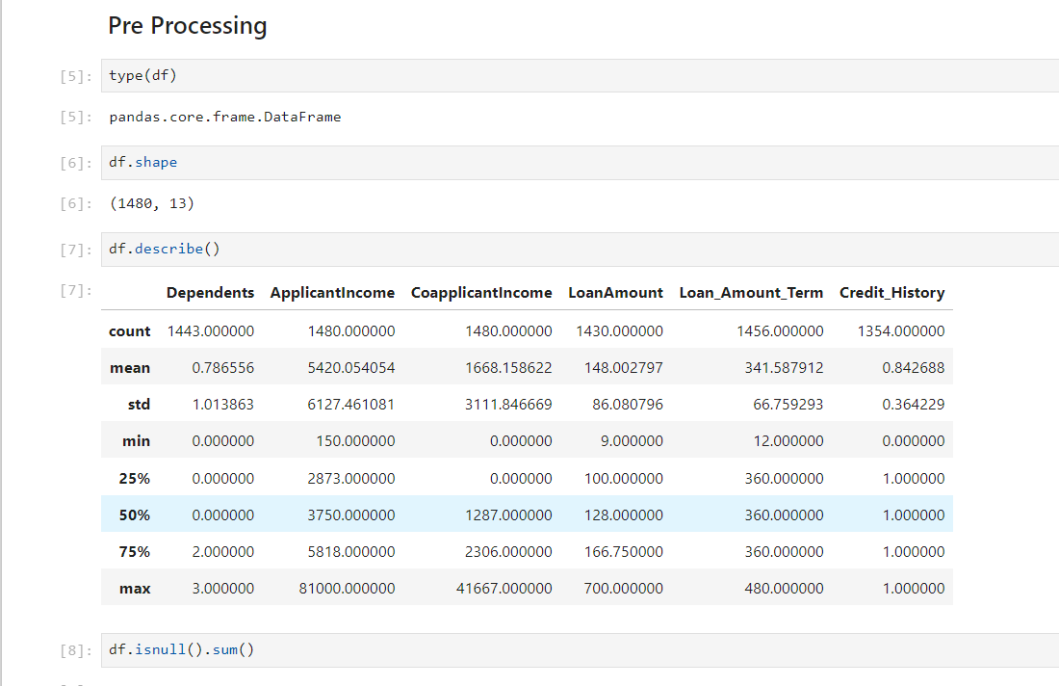

Slide 32
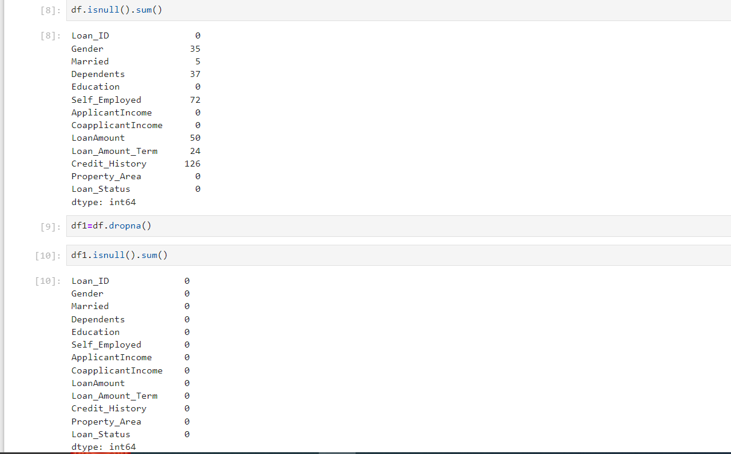

Slide 33
3. FEATURE EXTRACTION :
It is an attribute Reduction process
Feature extraction actually transforms the attributes The transformed attributes, or features, are linear combinations of the original attributes.
Finally, our models are trained using Classifier algorithm. We use classify module on Natural Language Toolkit library on Python. We use the labelled dataset gathered. The rest of our labelled data will be used to evaluate the models.
Some machine learning algorithms were used to classify pre-processed data. The chosen classifiers were Random forest. These algorithms are very popular in text classification tasks.

Slide 34
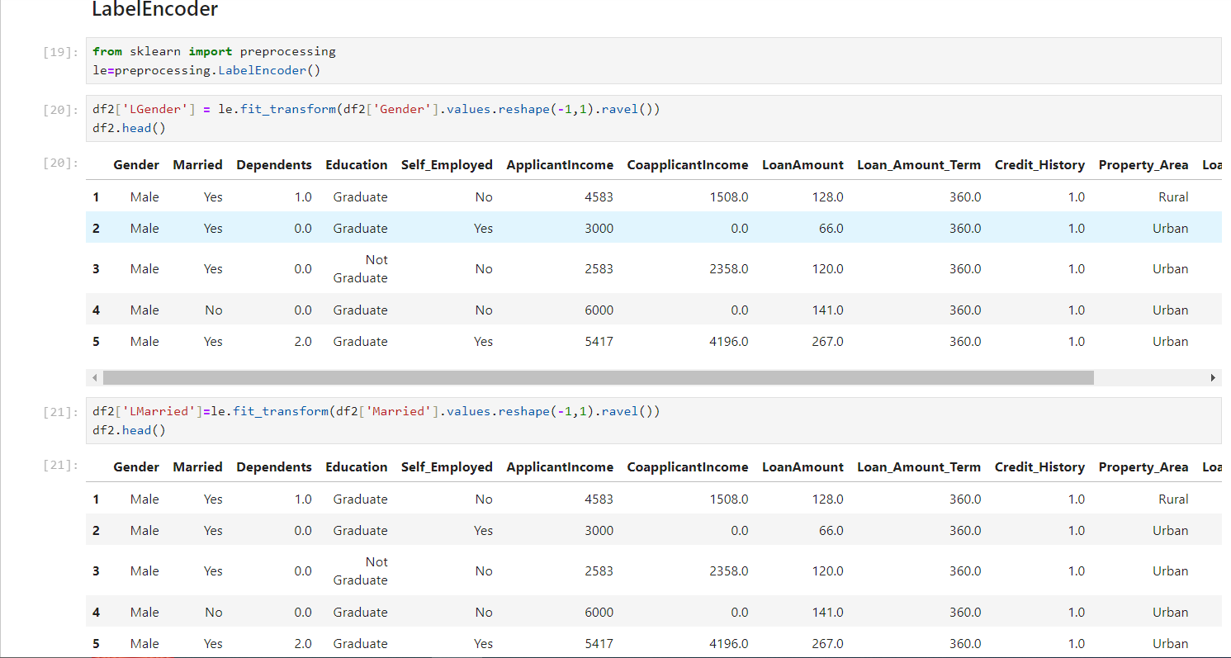

Slide 35
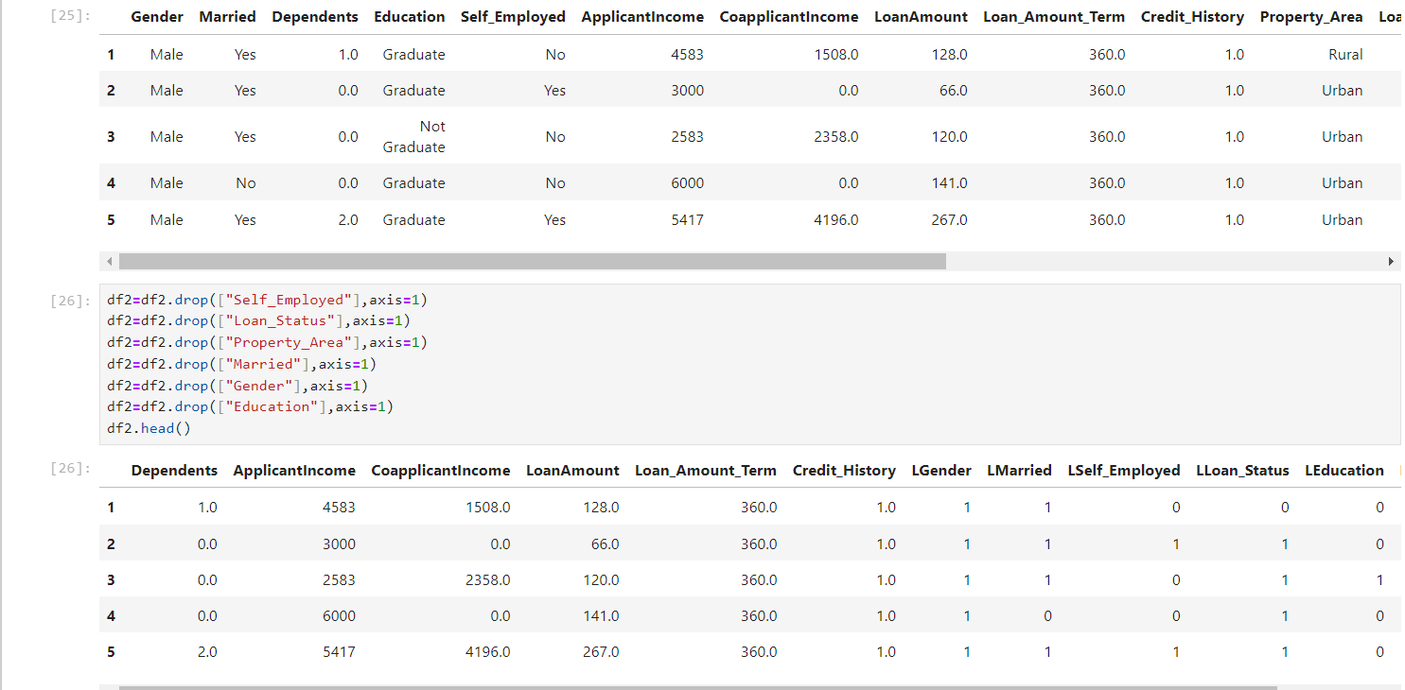

Slide 36
4. EVALUATION MODEL :
Model Evaluation is an integral part of the model development process. It helps to find the best model that represents our data and how well the chosen model will work in the future. Evaluating model performance with the data used for training is not acceptable in data science because it can easily generate overoptimistic and over fitted models. Performance of each classification model is estimated base on its averaged. The result will be in the visualized form. Representation of classified data in the form of graphs. Accuracy is defined as the percentage of correct predictions for the test data. It can be calculated easily by dividing the number of correct predictions by the number of total predictions.

Slide 37
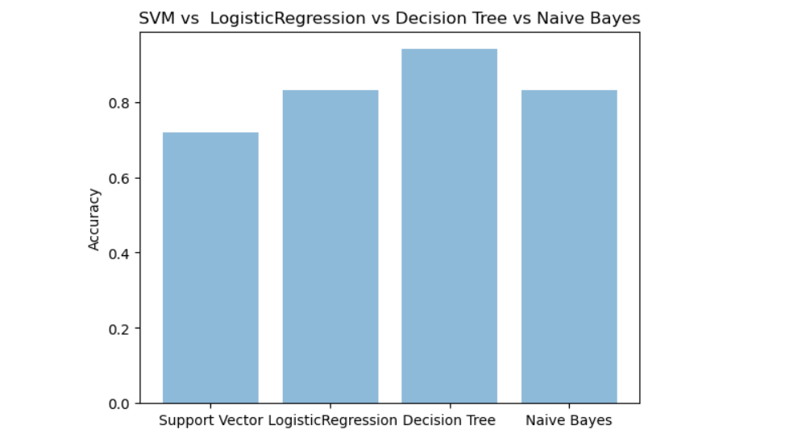

Slide 38
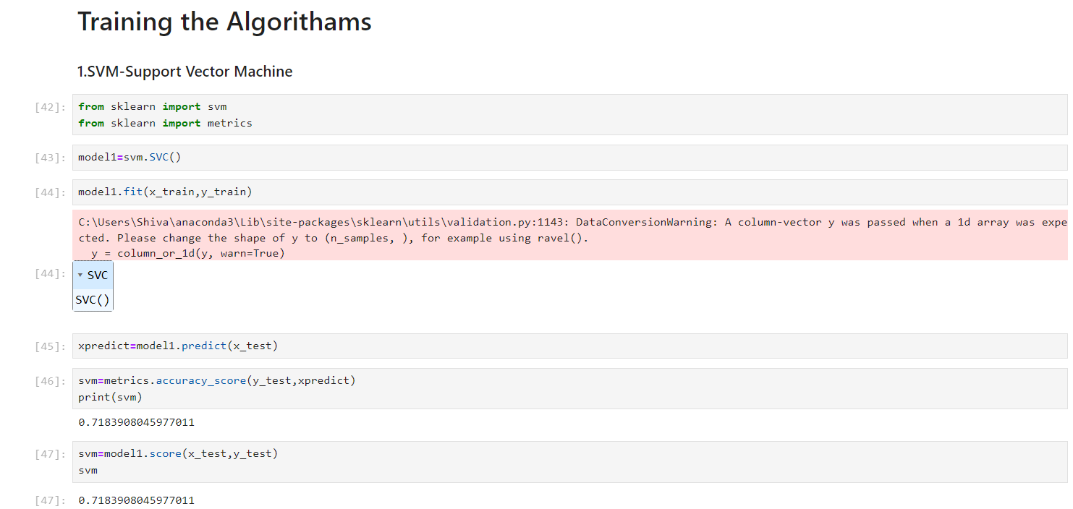
TRAINING ALGORITHMS :
T

Slide 39
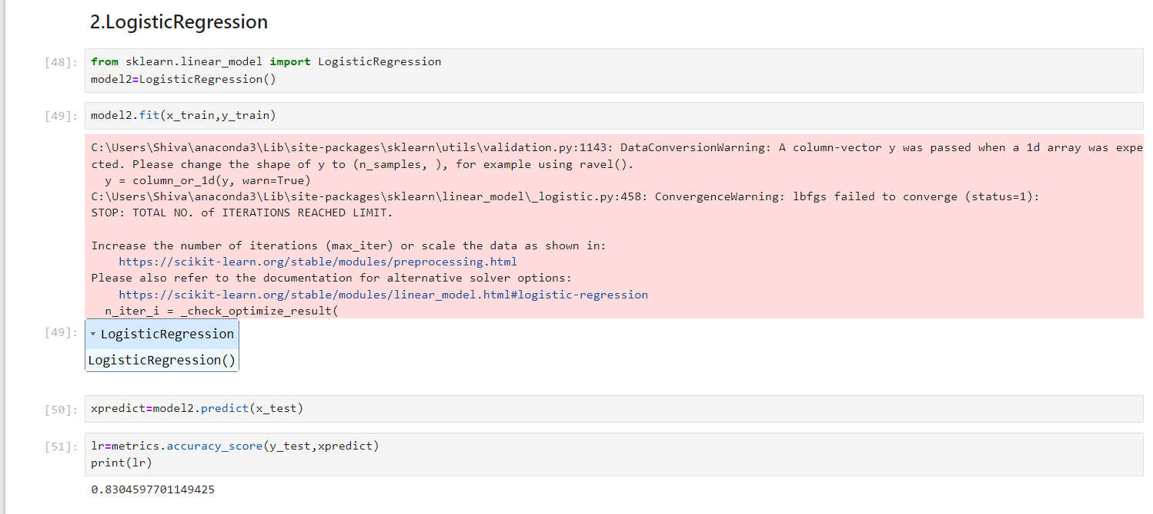

Slide 40
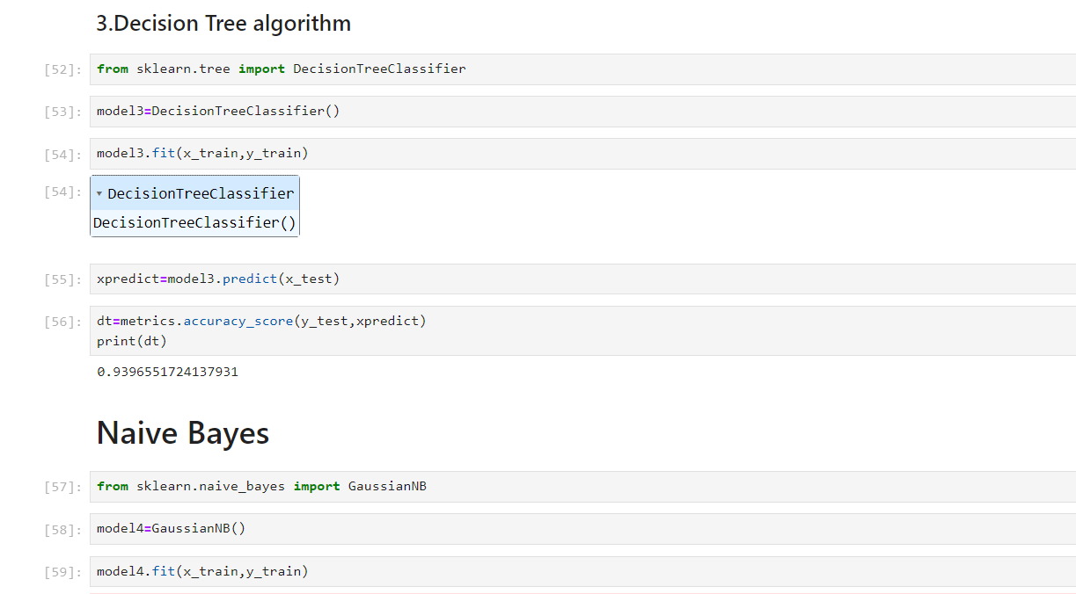

Slide 41
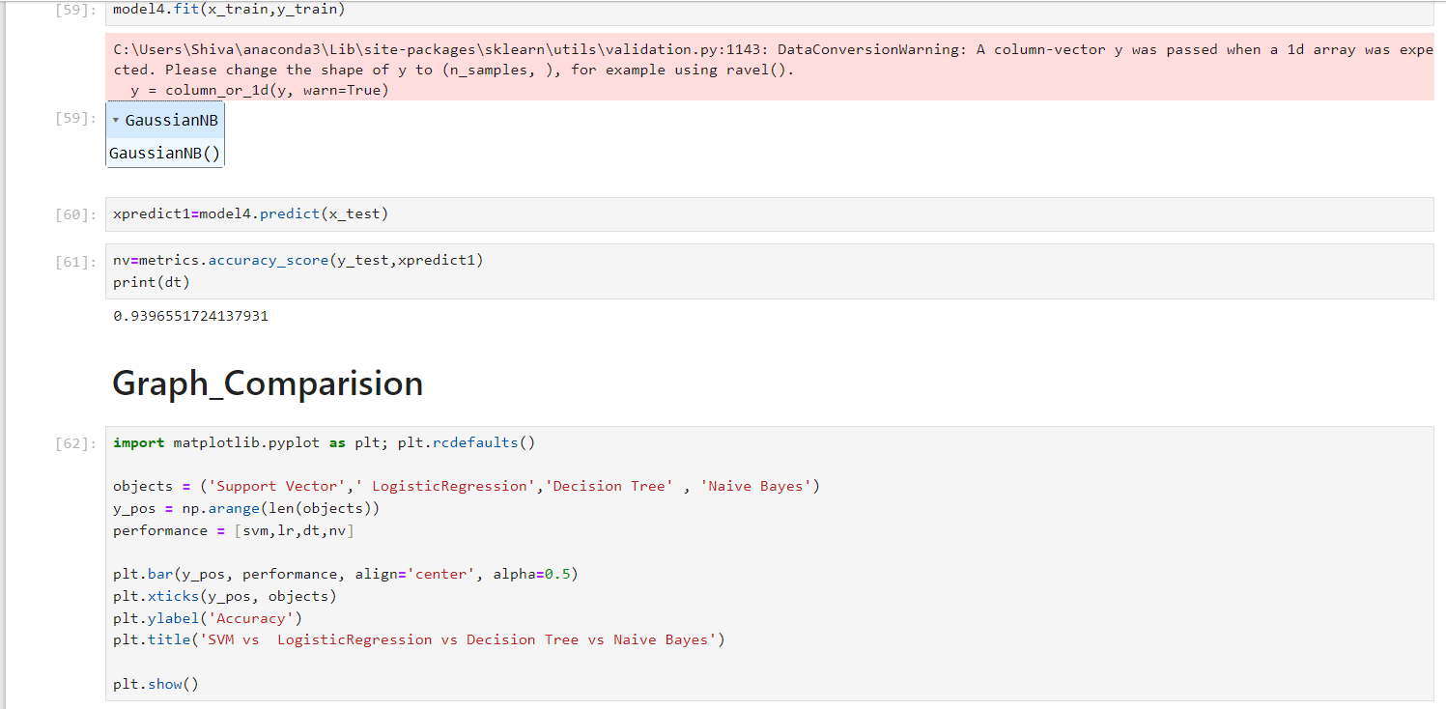

Slide 42
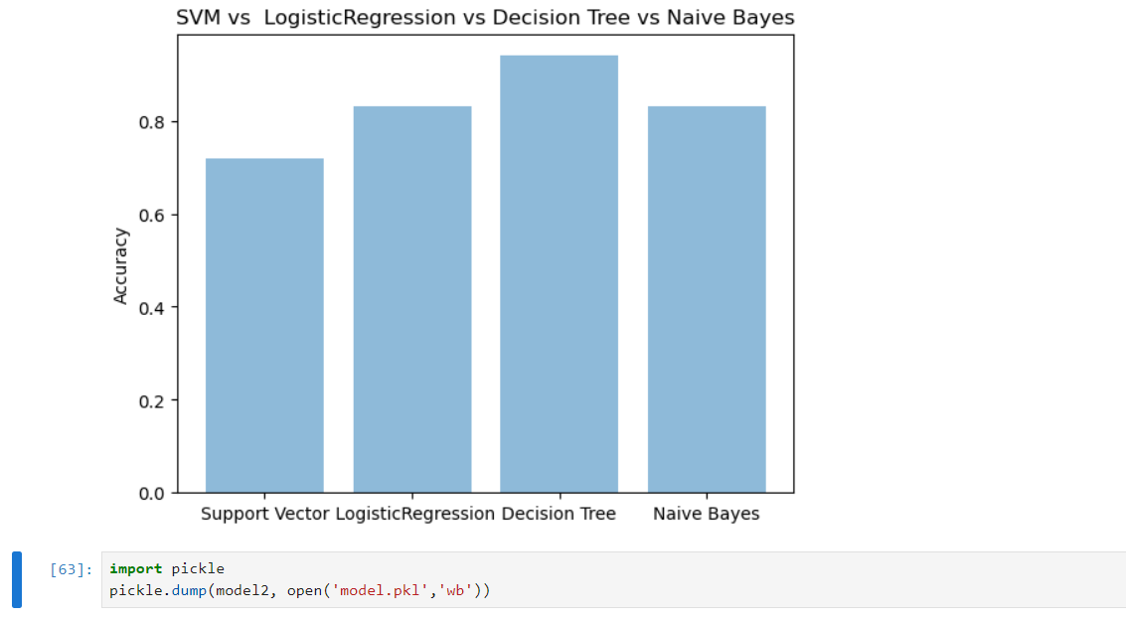

Slide 43
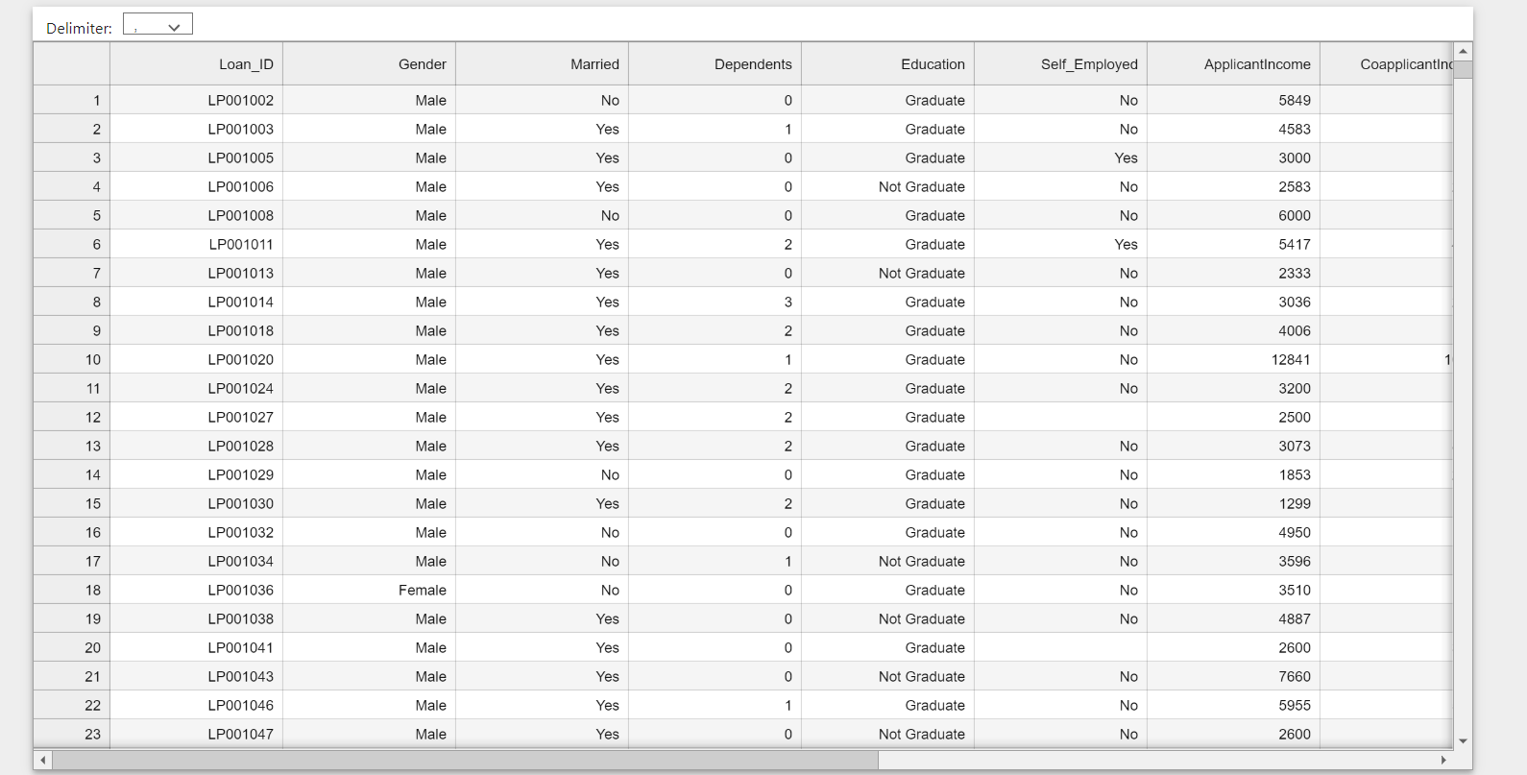
TEST CASES :

Slide 44
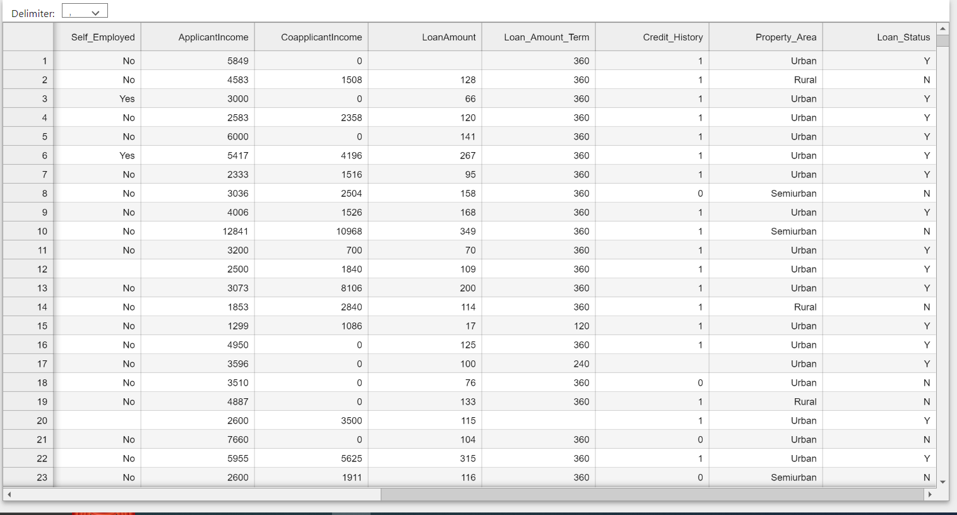

Slide 45
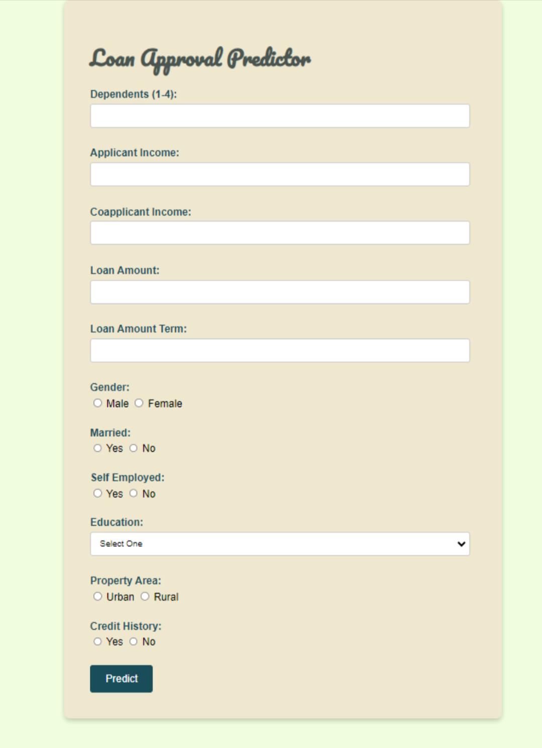
OUTPUT SCREEN :

Slide 46
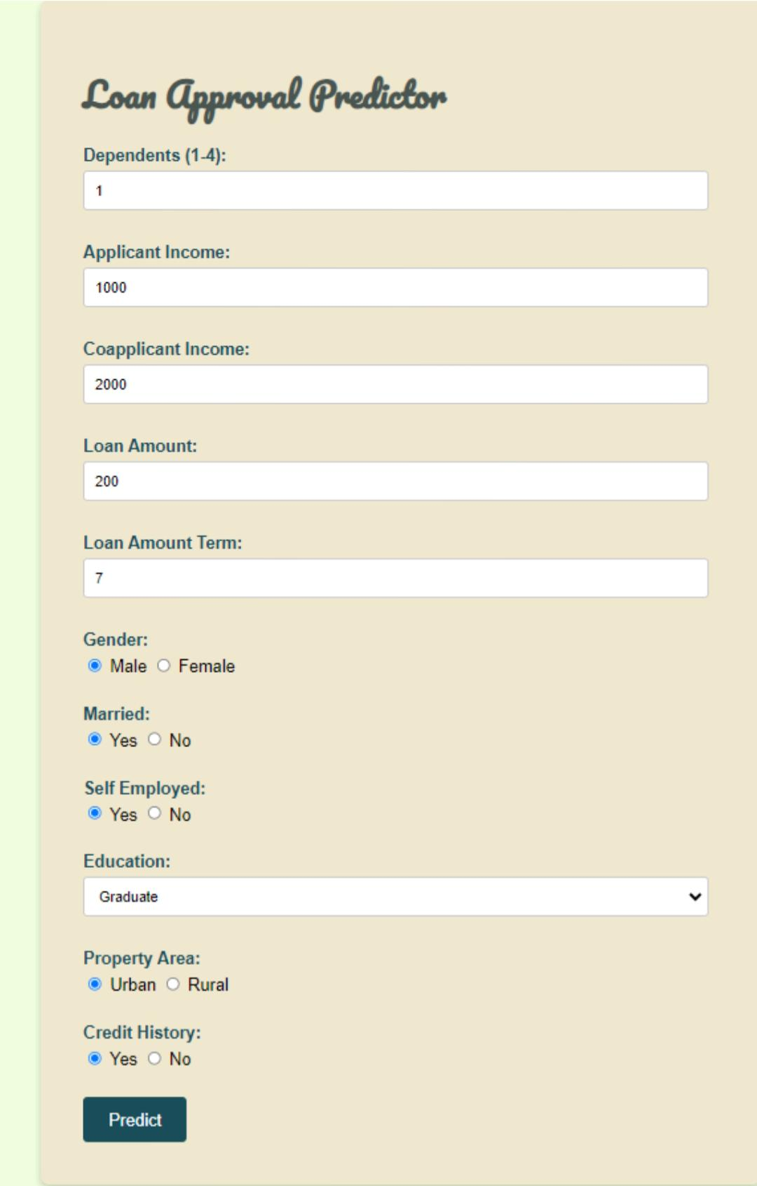
AFTER ENTERING DATA:

Slide 47
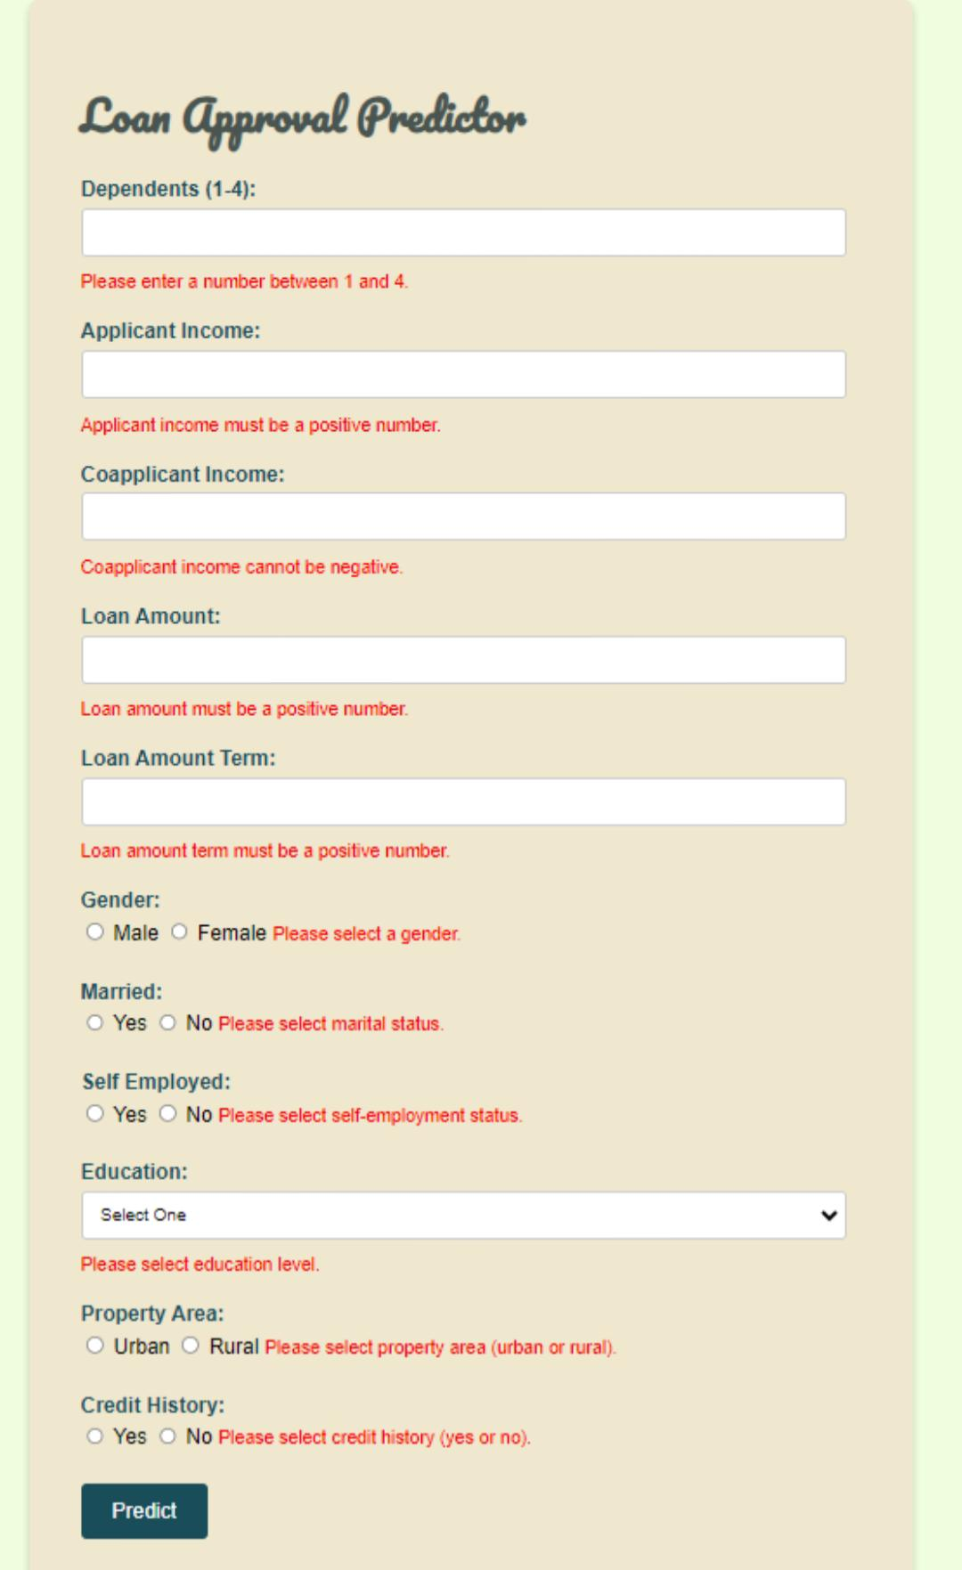

Slide 48
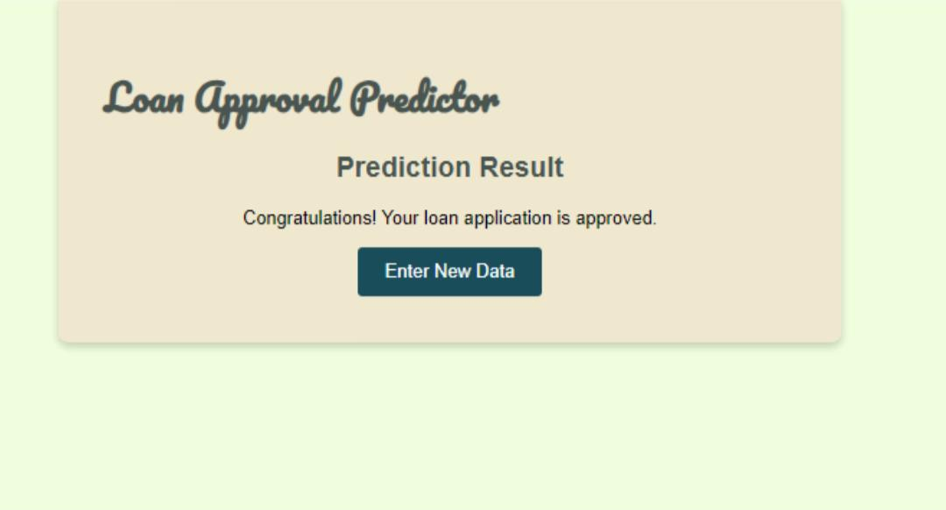
RESULT:

Slide 49
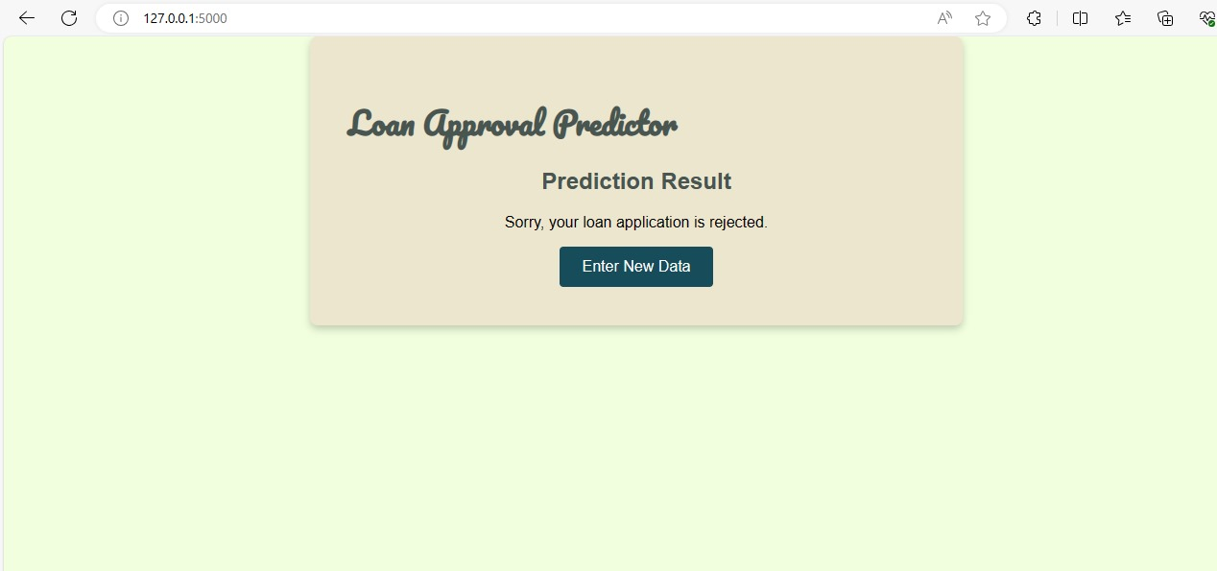

Slide 50
CONCLUSION:
The analytical process started from data cleaning and processing, Missing value imputation with packages, then exploratory analysis and finally model building and evaluation. The best accuracy on a public test set is 0.841 achieved the Stacking Classifier using Ensemble Learning. This brings some of the following insights about approval. Applicants with Credit history not passing fails to get approved, Probably because they have a probability of not paying back. Most of the Time, Applicants with high income sanctioning low amounts are more likely to get approved which make sense, more likely to pay back their loans. Some basic characteristic gender and marital status seems not to be taken into consideration by the company.

Slide 51
FUTURE WORK:
The future scope for loan approval prediction using machine learning is promising, and several trends and advancements are anticipated to shape this field. Here are some key areas of future scope: Enhanced Predictive Models: Continuous improvements in machine learning algorithms and techniques will lead to more sophisticated predictive models. Advanced models, such as deep learning architectures, may be explored to extract intricate patterns from large and complex datasets. Explainability and Interpretability: The need for transparent and interpretable machine learning models is gaining importance, especially in financial decision-making. Future research may focus on developing models that provide clear explanations for their predictions, ensuring regulatory compliance and user trust.

Slide 52
Integration of Alternative Data: Inclusion of non-traditional data sources, such as social media activity, online behaviour, and other alternative data points, to enhance the accuracy of credit risk assessment. Integrating a broader range of features can provide a more comprehensive view of an individual’s financial health.
Thank you

